Slide 1
Regulation of Entry
Simeon Djankov
Rafael La Porta
Florencio Lopez-De-Silanes
Andrei Shleifer
Quarterly Journal of Economics, 2002

Slide 2
Overview
Compare what it takes to start a new business in 85 countries; regulation of entry
Compare countries’ regulation of entry with prevalence of:
  Corruption
  Unofficial economy
  Quality of private and public goods
  Degree of democracy and “limited government”
Analyze with respect to theories on the topic; public interest theory and public choice theory
Conclusion: Regulation of entry benefits politicians and bureaucrats; supports public choice theory
Notes:
Procedures, time, cost

Slide 3
Public Interest Theory
Pigou 1938
Unregulated markets exhibit frequent failures
Efficiency requires regulation
Government screens new entrants and gives “official approval” stamp, signaling high quality products to consumers
View is that the greater the number of entry procedures, the greater the social outcome
Notes:
Market failures: monopoly power, externalities

Slide 4
Public Choice Theory
Regulation is inefficient:
  Regulatory capture: industry incumbents acquire regulations and create rents for themselves; less competition, higher profits, less benefit to consumers
  Tollbooth view: politicians and bureaucrats create regulation to later collect bribes in exchange for release from regulation; inefficiency comes from disorganized regulators and that the policies pursued to increase rents from corruption are distortionary

Slide 5
Rationale of Study
Who benefits from regulation?
  If public interest theory correct: higher regulation should be associated with higher quality goods, fewer market failures, and greater competition
  If public choice theory correct: higher regulation associated with less competition and higher corruption
Which type of government regulates entry?
  If public interest theory correct: the more representative and limited governments should regulate entry more strictly
  If public choice theory correct: governments least democratic and limited should pursue strictest regulations, to benefit themselves and incumbent firms
Notes:
More representative: govt interests more closely aligned with those of consumers

Slide 6
Data
Regulation of Entry:
Regulation procedures; 2 to 21, avg 10
Time to complete, 2 to 152, avg 47 bus. Days
Official cost, .5% GDP pc. to 4.6% GDP pc., avg 47% annual GNI pc
Regulation -> cumbersome, time-consuming, expensive
Collected from government, World Bank, USAID publications, and webpages
Rents from Regulation:
Compliance with International Quality standards
Level of water pollution
Number of deaths from accidental poisoning and intestinal infections
Measures of unofficial output and employment
Survey measure of “product market competition”
Notes:
Quality stds: good focus if goal is to screen out low quality firms
Water pollution should fall if entry regulation successfully controls externalities
Publicly interested regulation should be associated with less accidental poisonings
Higher entry regulation should be associated with greater competition in the public interest theory, and lacking competition in the public choice theory

Slide 7
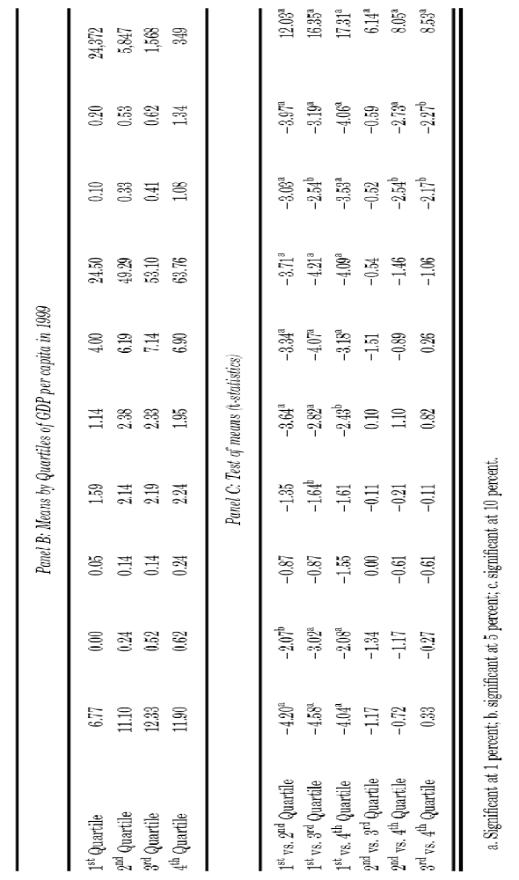
Notes:
Screening procedures are biggest part of procedures
Countries in top quartile of GDP pc require fewer procedures and entrepreneurs face fewer delays than in other quartiles

Slide 8
Interpretation
Regulation often takes form of screening procedures
Rich countries regulate less
Market failures might be more pervasive in countries below first quartile
        and
Income levels may proxy for characteristics of political systems that allow politicians to benefit from regulation

Slide 9
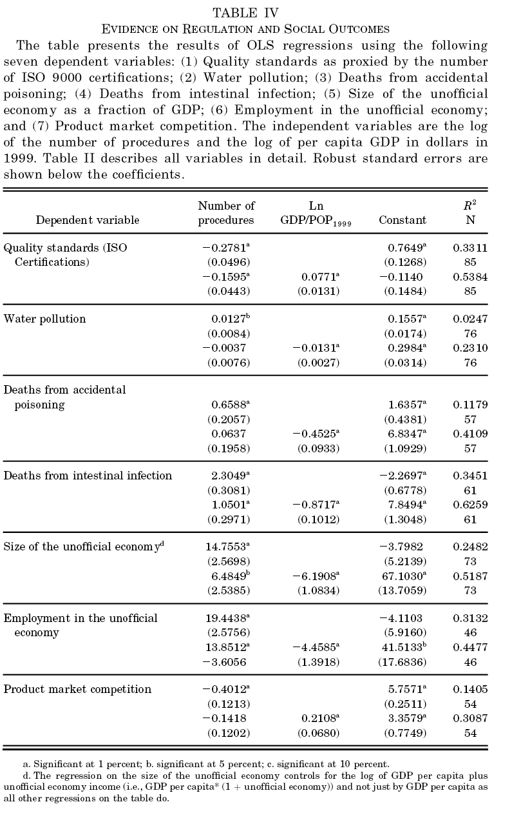
Notes:
Seven measures of consequences of regulation using # of procedures as dependent variables
with and w/out log pc GDP- # of procedures correlated with income pc and wanted to make sure to not pick up effects of good governance associated with higher income. GDP used as rough proxy of prevalence of market failures in a country..
Intl quality stds declines as number of procedures rises.
Pollution levels do not fall with regulation levels
Two measures of accidental poisoning are not lower in countries with more regulation
More regulaiton associated with larger unofficial economy
Competition in countries with more regulation is perceived to be less intense
Some measures are more relevant in poor countries, most likely uninfluenced by regulation in rich countries..performed analysis for different income levels; divided sample at median income pc and reran the regressions
-> data does not support the conclusion that in poor countries, heavier regulation is associated with better social outcomes or more competition

Slide 10
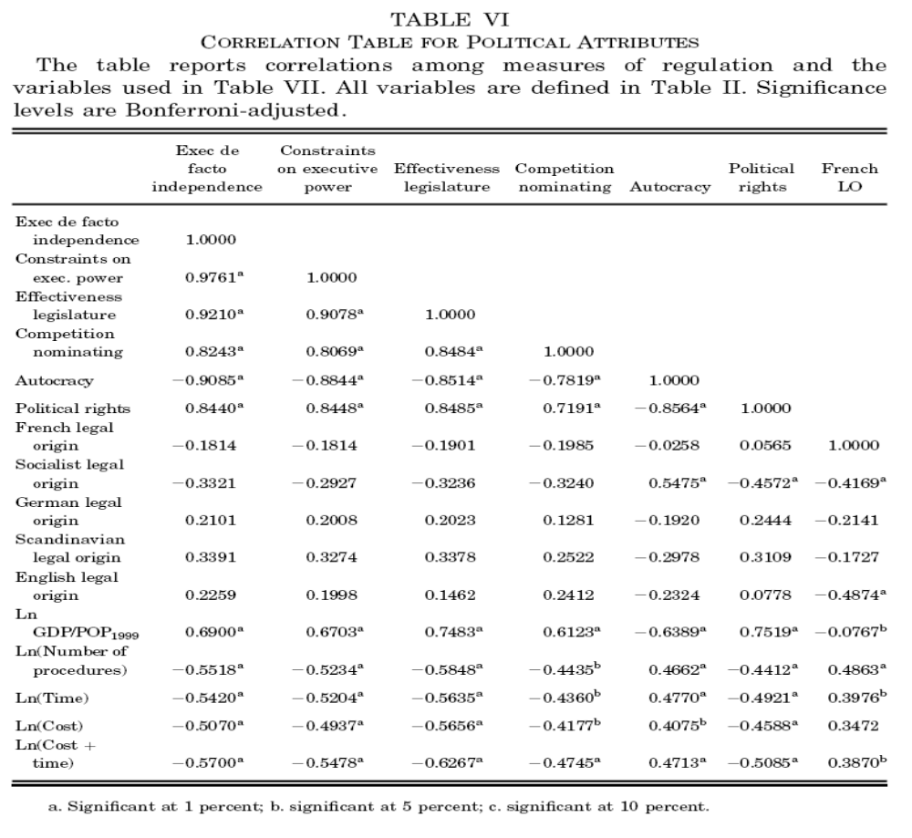

Slide 11
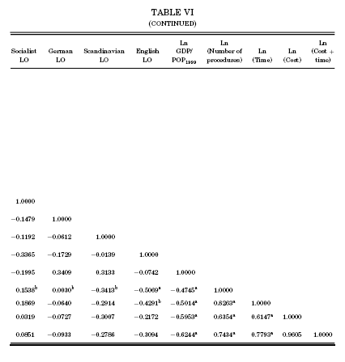
Notes:
The number of procedures is highly correlated with both the time and cost variables -> entrepreneur pays steep price in terms of fees and delays in countries that make intense use of ex ante screening.
World avg time + cost represents 66% of GDP

Slide 12
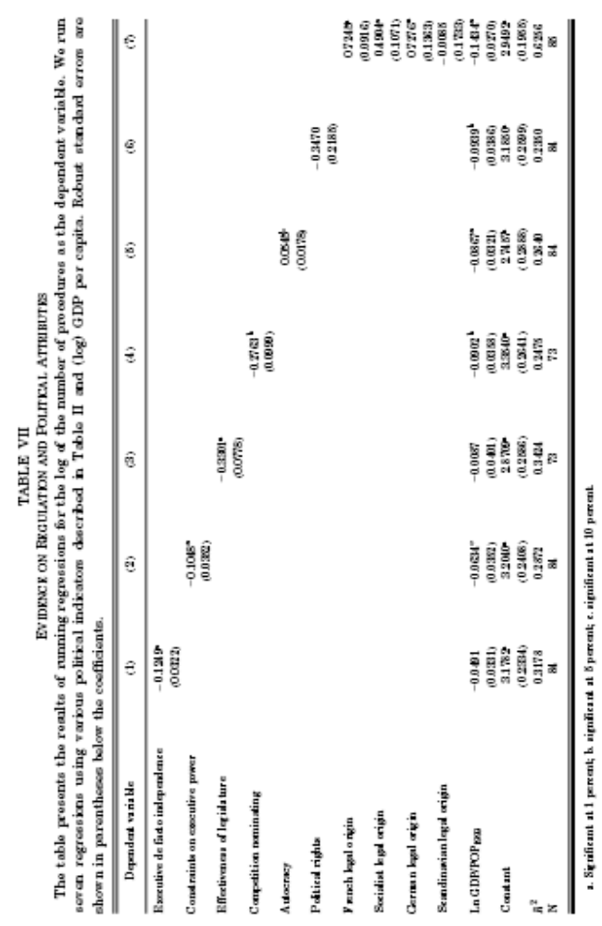
Notes:
Regression of number of procedures on the political variables one at a time and then for log of pc income
Holding pc income constant, countries with more limited and representative govts have statistically significantly fewer procedures for entry regulation using five of the six measures of better govt
Holding per capita income constant, countries of french, German and socialist legal origin have more regulations than English legal origin countries, while countries of Scandinavian legal origin have about the same
-> civil law countries regulate entry more heavily -> supports view that legal origin proxies for the state’s inclination to intervene in economic life

Slide 13
Conclusion
Heavier regulation of entry associated with:
  Greater corruption and larger unofficial economy
  But not with better quality of private or public goods
Countries with less limited, less democratic, and more interventionist governments regulate entry more heavily (even controlling for level of economic development)
Evidence supports public choice approach

